Slide 1
23
9
2
3
1
18
14
2
6
6
30
11
4
19
15
5
5
20
16
6
7
44
8
Teori Graf

Slide 2
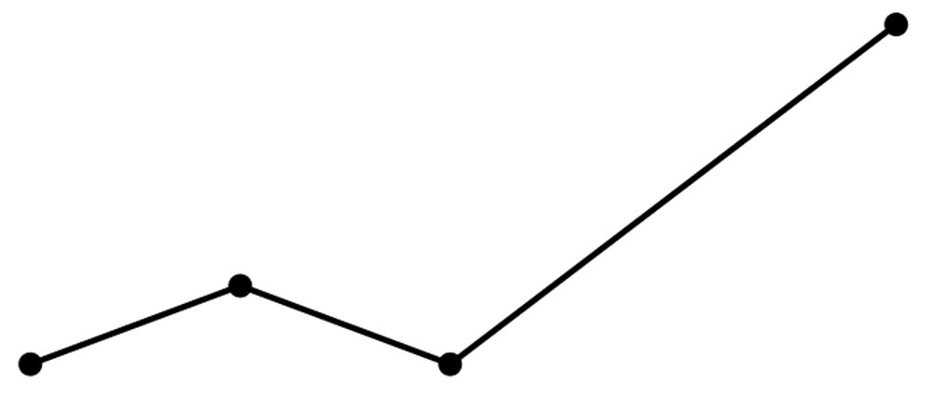
Graph
graph

Slide 3
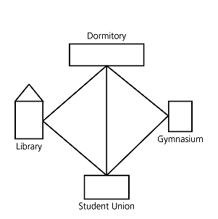
Vertice & Edge
vertices
edges
graph

Slide 4
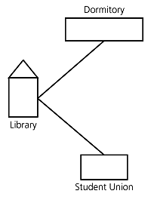
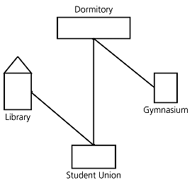
Subgraph & Spanning Subgraph
subgraph
Spanning subgraph

Slide 5
Subgraphs
A subgraph S of a graph G is a graph such that
  The vertices of S are a subset of the vertices of G
  The edges of S are a subset of the edges of G
A spanning subgraph of G is a subgraph that contains all the vertices of G
Subgraph
Spanning Subgraph

Slide 6
Adjacent Vertices
adjacent
D
E
A
adjacent
C
B

Slide 7
Path
D
E
D
E
A
C
A
B
path
C
B
simple path

Slide 8
Cycle
D
E
D
E
A
C
A
B
cycle
C
B
simple cycle

Slide 9
Connectivity
A graph is connected if there is a path between every pair of vertices
A connected component of a graph G is a maximal connected subgraph of G
Connected graph
Non connected graph with two connected components
Complete graph

Slide 10
Trees and Forests
A (free) Tree is an undirected graph T such that
  T is connected
  T has no cycles
  This definition of tree is different from the one of a rooted tree
A Forest is an undirected graph without cycles
The connected components of a forest are trees
Tree
Forest

Slide 11
Spanning Trees and Spaning Forests
A spanning tree of a connected graph is a spanning subgraph that is a tree
A spanning tree is not unique unless the graph is a tree
Spanning trees have applications to the design of communication networks
A spanning forest of a graph is a spanning subgraph that is a forest
Graph
Spanning tree

Slide 12
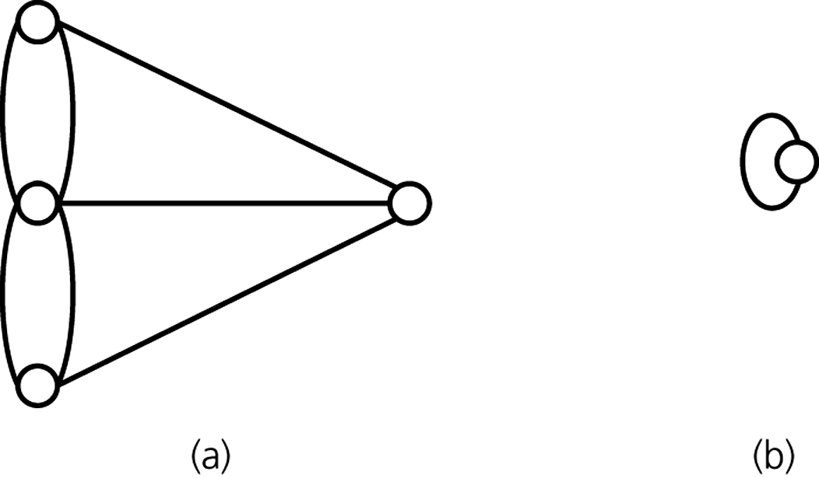
Multigraph & Selfloop
loop
self edge
multigraph

Slide 13
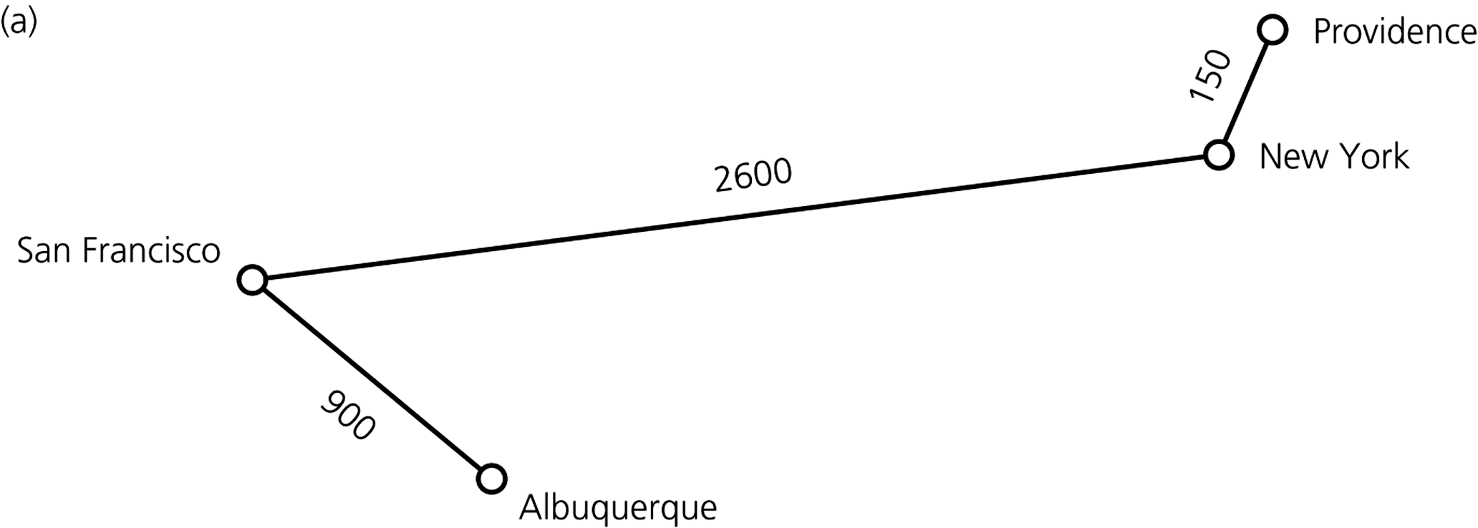
Weighted Graph
weighted graph

Slide 14
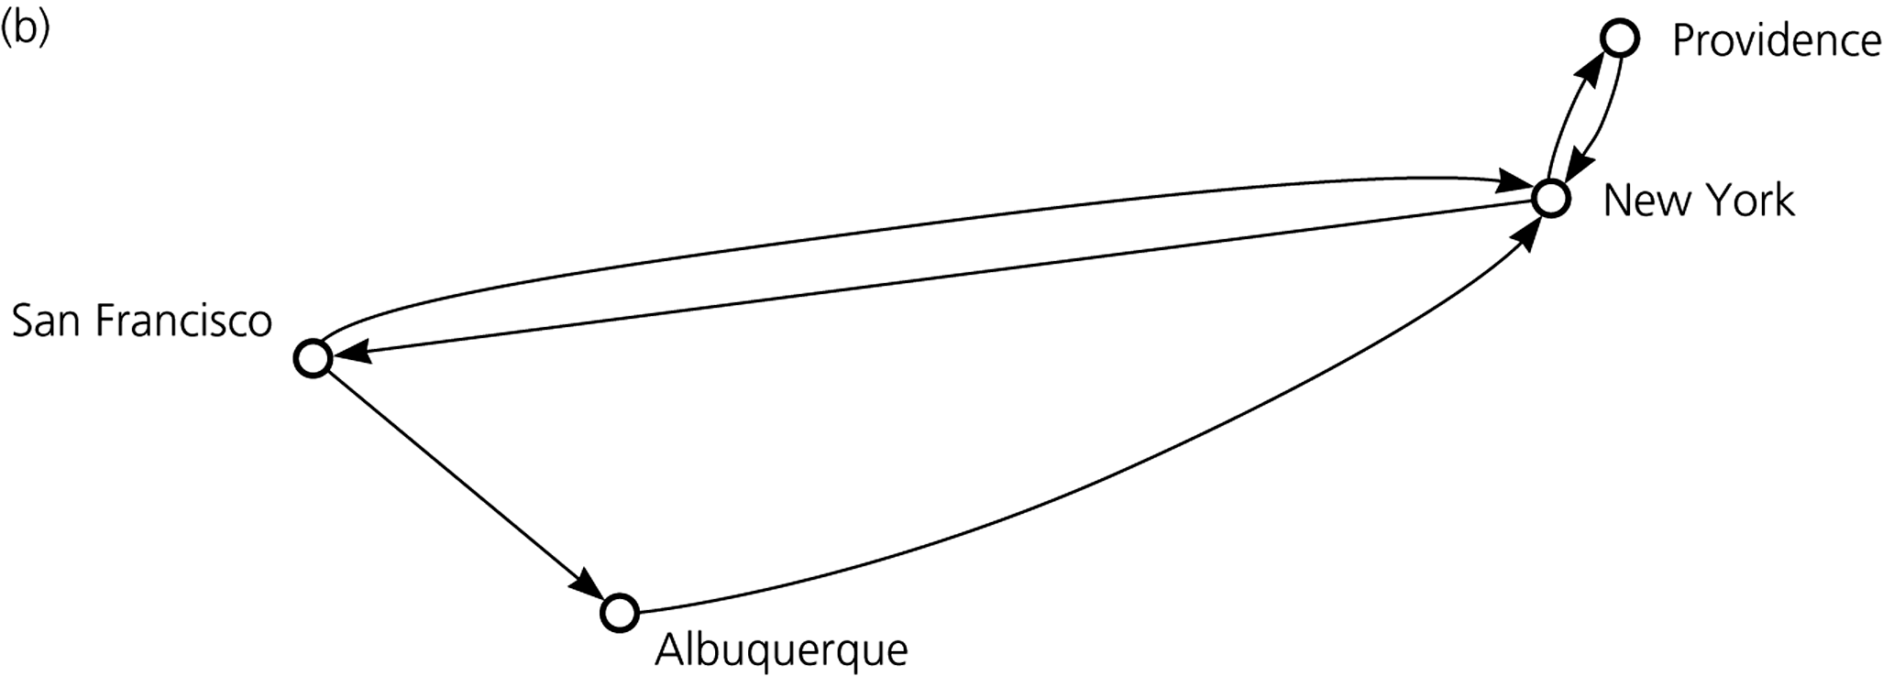
Directed Graph
directed graph
Question: Is New York adjacent to Albuquerque?

Slide 15
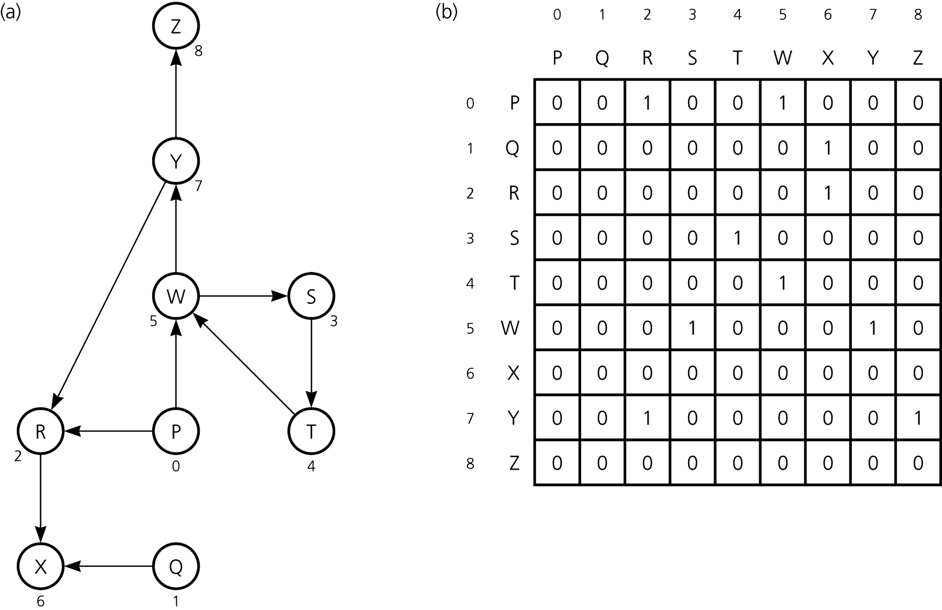
- Graph Implementation –
Adjacency Matrix

Slide 16
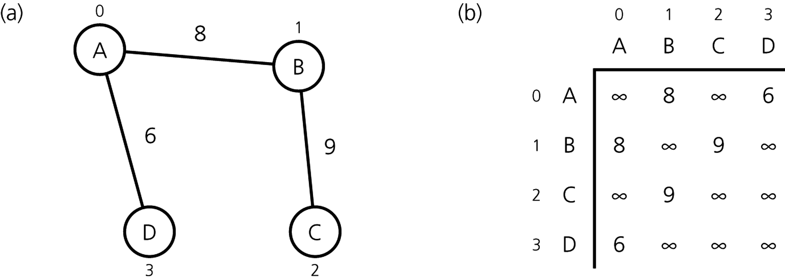
Adjacency Matrix for Weighted Graphs

Slide 17
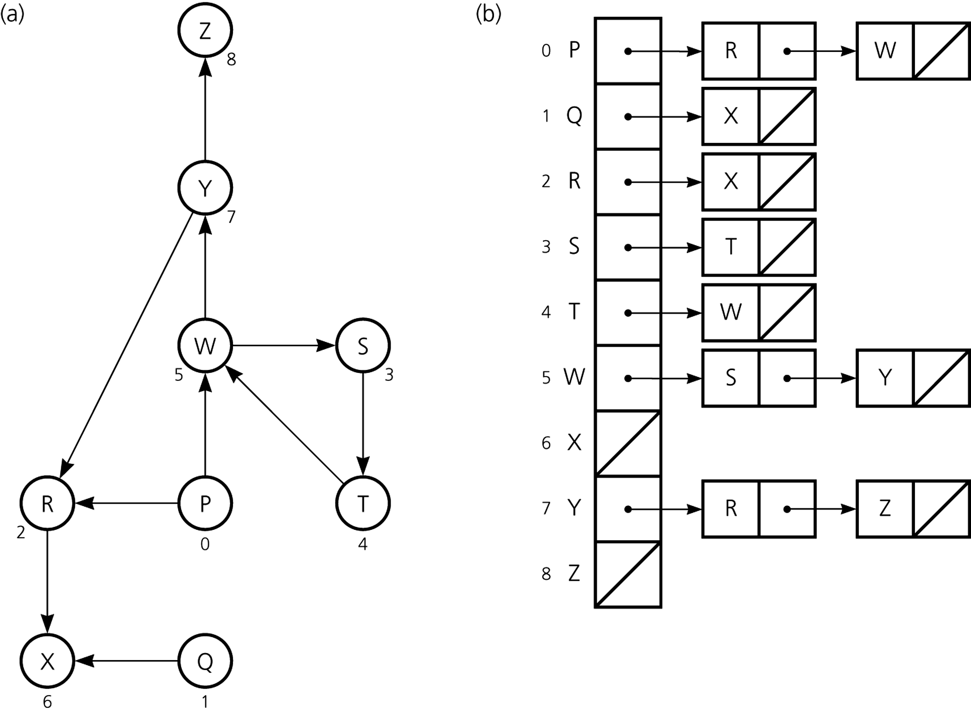
Graph Implementation –
Adjacency List

Slide 18
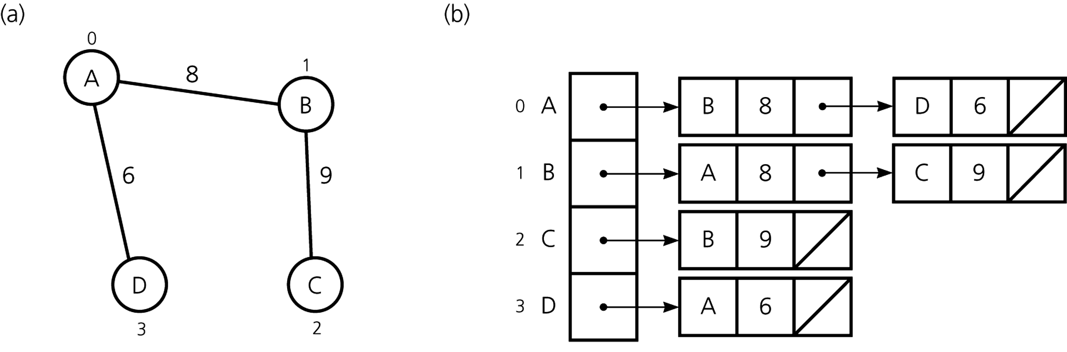
Adjacency List for Weighted Graph

Slide 19
Efficiency Considerations
Common operations
  determine whether there is an edge between
  vertices i and j
  find all vertices adjacent to a given vertex i
Space requirements
  matrix of integers vs. pointered list of node elements

Slide 20
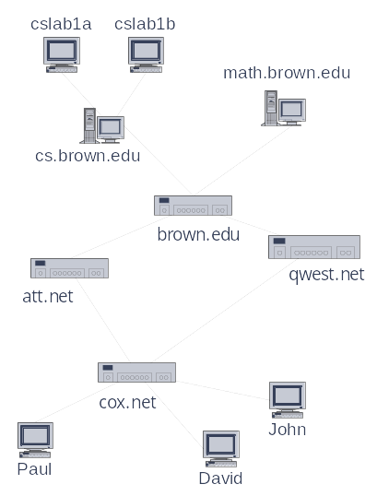
Applications
Electronic circuits
  Printed circuit board
  Integrated circuit
Transportation networks
  Highway network
  Flight network
Computer networks
  Local area network
  Internet
  Web
Databases
  Entity-relationship diagram
  Others Diagrams
Computer Games
Etc

Slide 21
Main Methods of the Graph ADT
Vertices and edges
  are positions
  store elements
Constructor/Destructor
  createGraph()
  destroyGraph()
Accessor methods
  aVertex()
  incidentEdges(v)
  endVertices(e)
  isDirected(e)
  origin(e)
  destination(e)
  opposite(v, e)
  areAdjacent(v, w)
Update methods
  insertVertex(o)
  insertEdge(v, w, o)
  insertDirectedEdge(v, w, o)
  removeVertex(v)
  removeEdge(e)
Generic methods
  numVertices()
  numEdges()
  vertices()
  edges()
(see The Graphs Book)

